Slide 1



Project24
TEAM
MediGuardians
Problem Statement Title- Online testing and monitoring of
quality of medicines and consumables
1

Slide 2

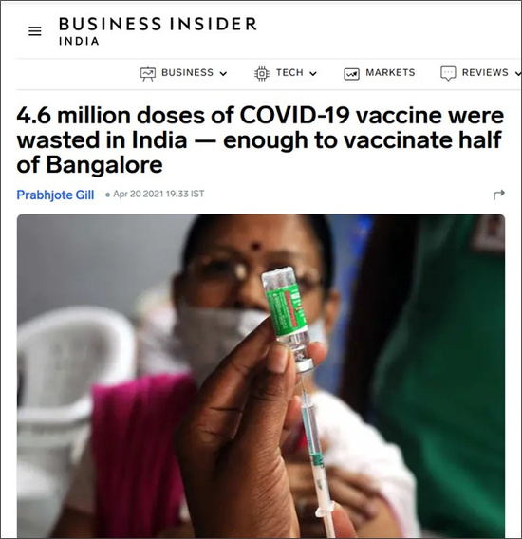
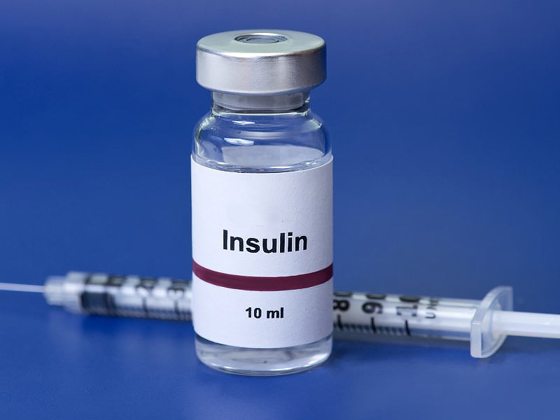
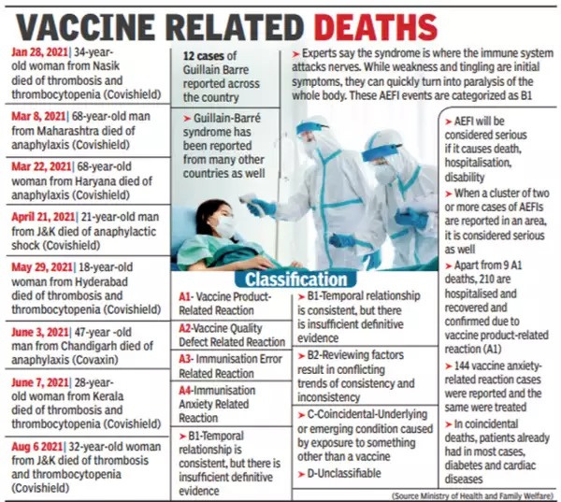
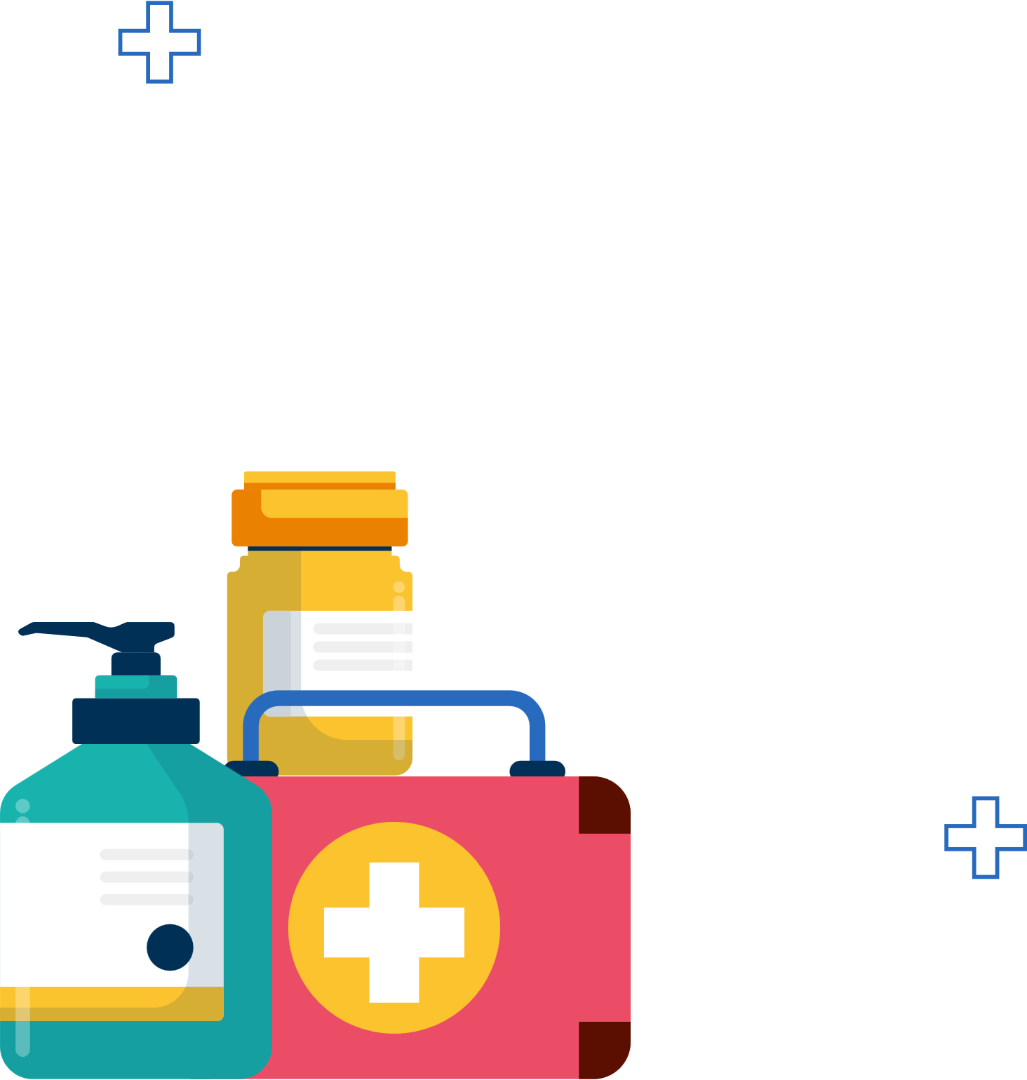
Imagine a shipment of insulin—a life-saving medicine that needs to be kept between 2°C and 8°C during transit. If this temperature range is not maintained, the insulin can become ineffective, endangering patients' lives.
2

Slide 3

SOLUTION
Automated Medicine Testing & Monitoring System
Our system ensures medicine effectiveness, safety, and authenticity by integrating IoT, automation, and blockchain for real-time monitoring and inventory management.
It analyzes patient recovery data, side effects, and expiration-based potency to categorize medicines and recommend the most effective options. IoT sensors monitor temperature and humidity to maintain proper storage conditions, triggering alerts if deviations occur.
A FIFO inventory system ensures older medicines are used first, minimizing waste, while an automated rejection mechanism removes expired or improperly stored medicines. Blockchain traceability secures the supply chain, preventing counterfeit drugs and ensuring regulatory compliance.
This integrated approach enhances treatment outcomes, reduces waste, and optimizes hospital medicine management.
3

Slide 4

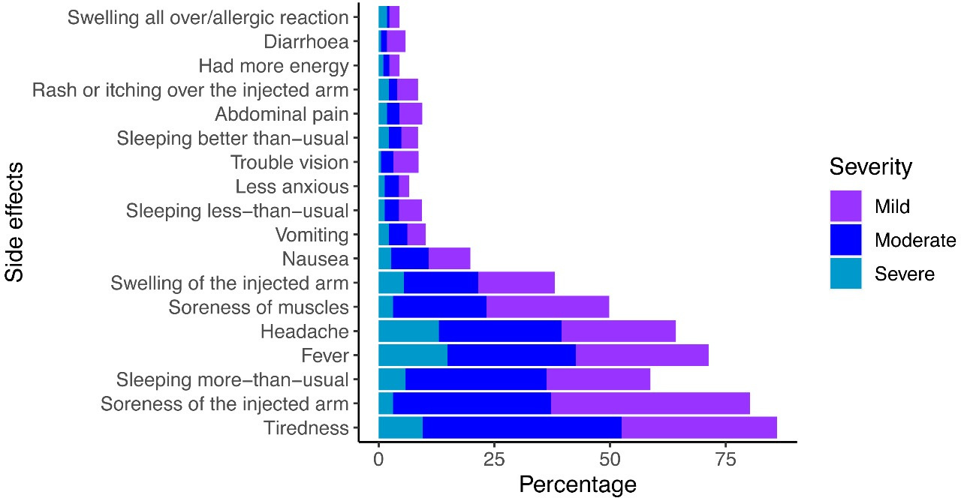
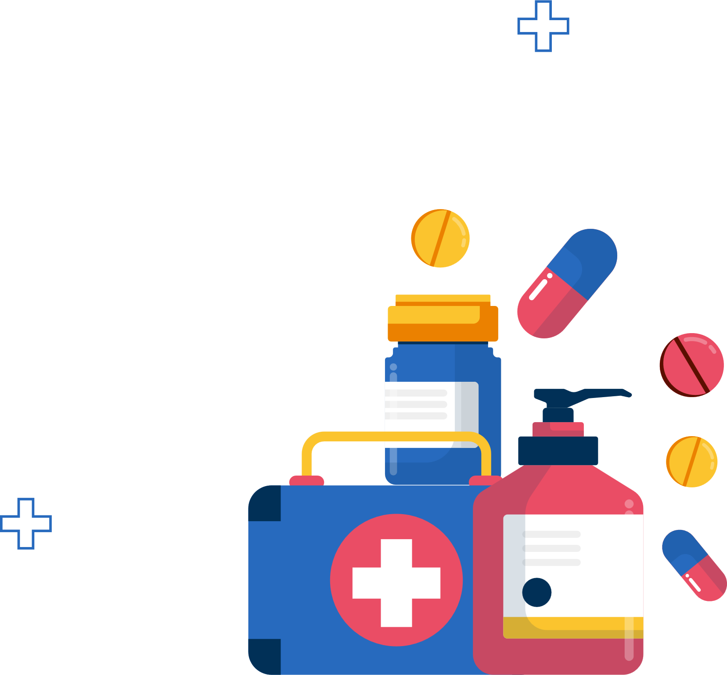
HOW IT ADRESSESES SOLUTION
Our system enhances medicine quality, transparency, efficiency, and compliance through advanced monitoring and automation.
Quality Control: Continuous IoT-based monitoring of storage conditions (temperature, humidity) ensures medicines remain effective and safe for use.
Transparency: Blockchain integration provides an immutable record of each batch’s journey, preventing counterfeit medicines and enhancing accountability.
Efficiency: Automated processes for medicine effectiveness analysis, inventory management, and rejection of expired medicines reduce manual effort, improving hospital workflows.
Compliance: The system ensures adherence to proper handling, expiry dates, and dosage guidelines, safeguarding patient health and regulatory standards.
This holistic approach improves medicine safety, optimizes inventory usage, and enhances hospital operations.
4

Slide 5

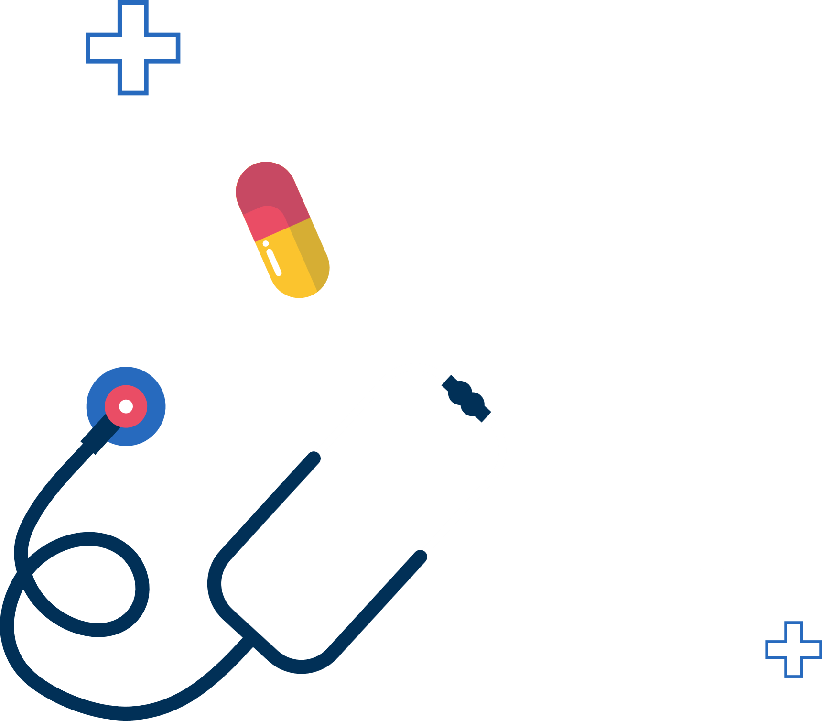
UNIQUENESS
01
02
03
Combines IoT and blockchain for dual-layer transparency and real-time quality assurance.
Tracks recovery time, side effects, and expiration impact to recommend the best medicine, while automated rejection rules remove unsafe medicines.
FIFO inventory system integrated with IoT and blockchain ensures proper stock management and traceability at every stage.
5

Slide 6

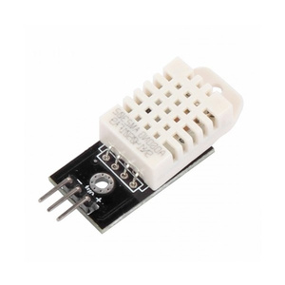
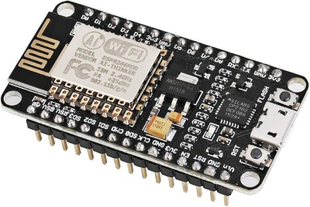
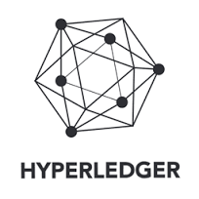

TECHNOLOGIES
•IoT Monitoring:
•Sensors: NodeMCU/ESP32 with DHT22 for temperature & humidity.
•Cloud: AWS IoT for data storage and monitoring.
•Real-Time Alerts:
•Python: To trigger alerts via AWS IoT for unsafe conditions.
•FIFO Inventory Management:
•Python: Automates First-In-First-Out tracking and expiry checks.
•MongoDB: Stores inventory data.
•Blockchain for Traceability:
•Hyperledger/Hedera: Tracks medicine supply chain with smart contracts.
•Automated Rejection:
•Python: Automatically rejects low-quality or expired supplies.
•React.js: Displays rejected batches and sends alerts.
6

Slide 7
Cost Savings:
IMPACT AND BENEFITS
Medicine Safety:
Transparency:
Real-time monitoring ensures medicines stay safe throughout the supply chain.
Blockchain tracks every step, providing secure, transparent records.
IoT sensors detect issues early, reducing wastage and saving costs.
Authenticity:
Scalability:
Improved
Treatment Outcomes:
RFID verifies medicines and helps meet regulatory requirements.
Medicine effectiveness analysis uses recovery data to recommend the best option for faster recovery.
The system can grow and integrate advanced features like AI for optimization.
7

Slide 8
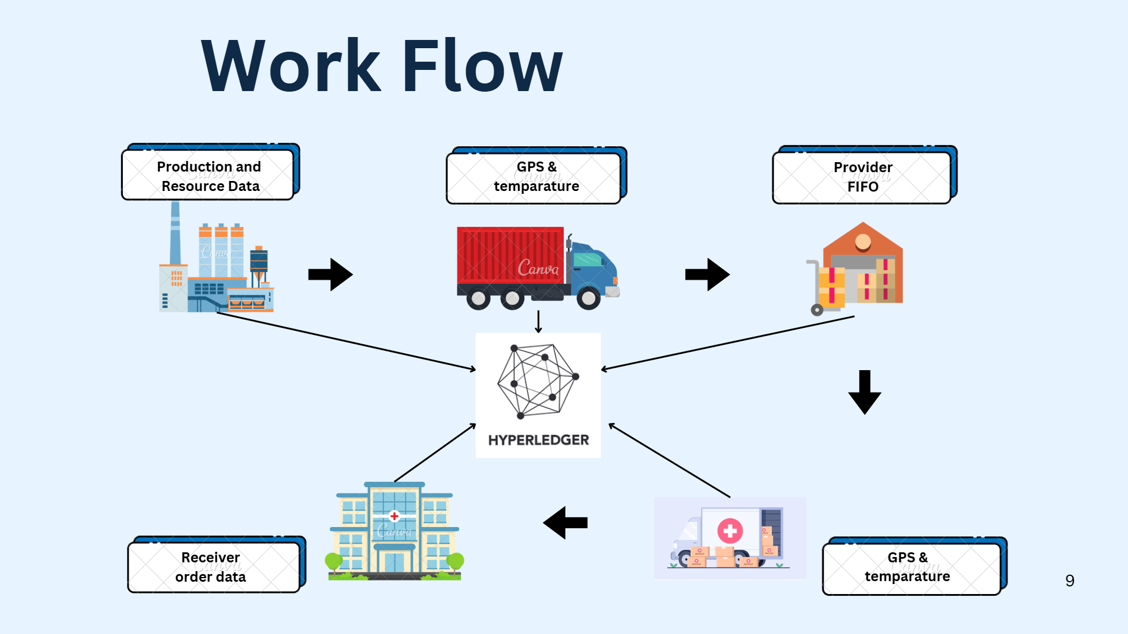

Slide 9

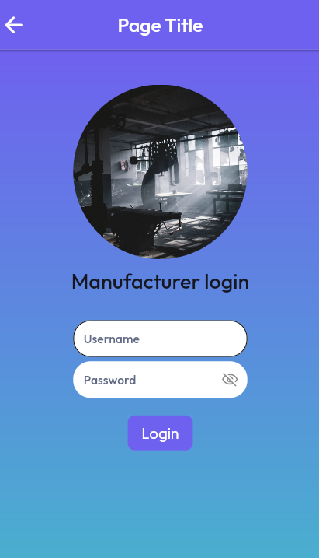
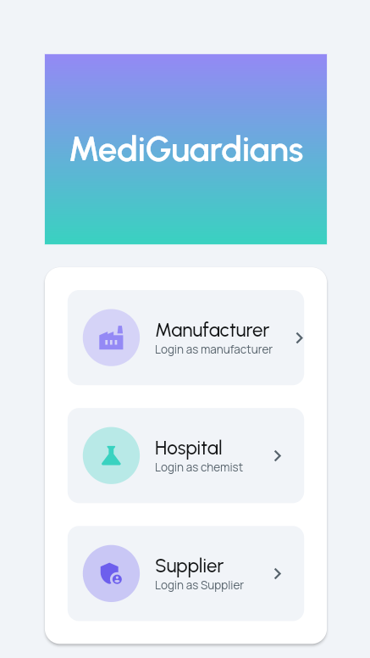

SNEAK PEAK OF
APP
INTERFACE
10

Slide 10


Feasibility & Viability
Technical: Utilizes IoT, blockchain, and cloud services, with development in React, Python, and PostgreSQL/MongoDB. Medicine effectiveness analysis is implemented using structured data processing for accurate recommendations.
Operational: Easily integrates into hospital workflows with automated medicine tracking, rejection, and effectiveness analysis, requiring minimal training for medical staff.
Financial: Initial costs are justified by long-term savings through automated inventory management, waste reduction, and improved medicine utilization based on effectiveness data.
Viability: Scalable for hospitals of all sizes, addressing a critical need for automated medicine quality control, effectiveness testing, and personalized medicine
11

Slide 11




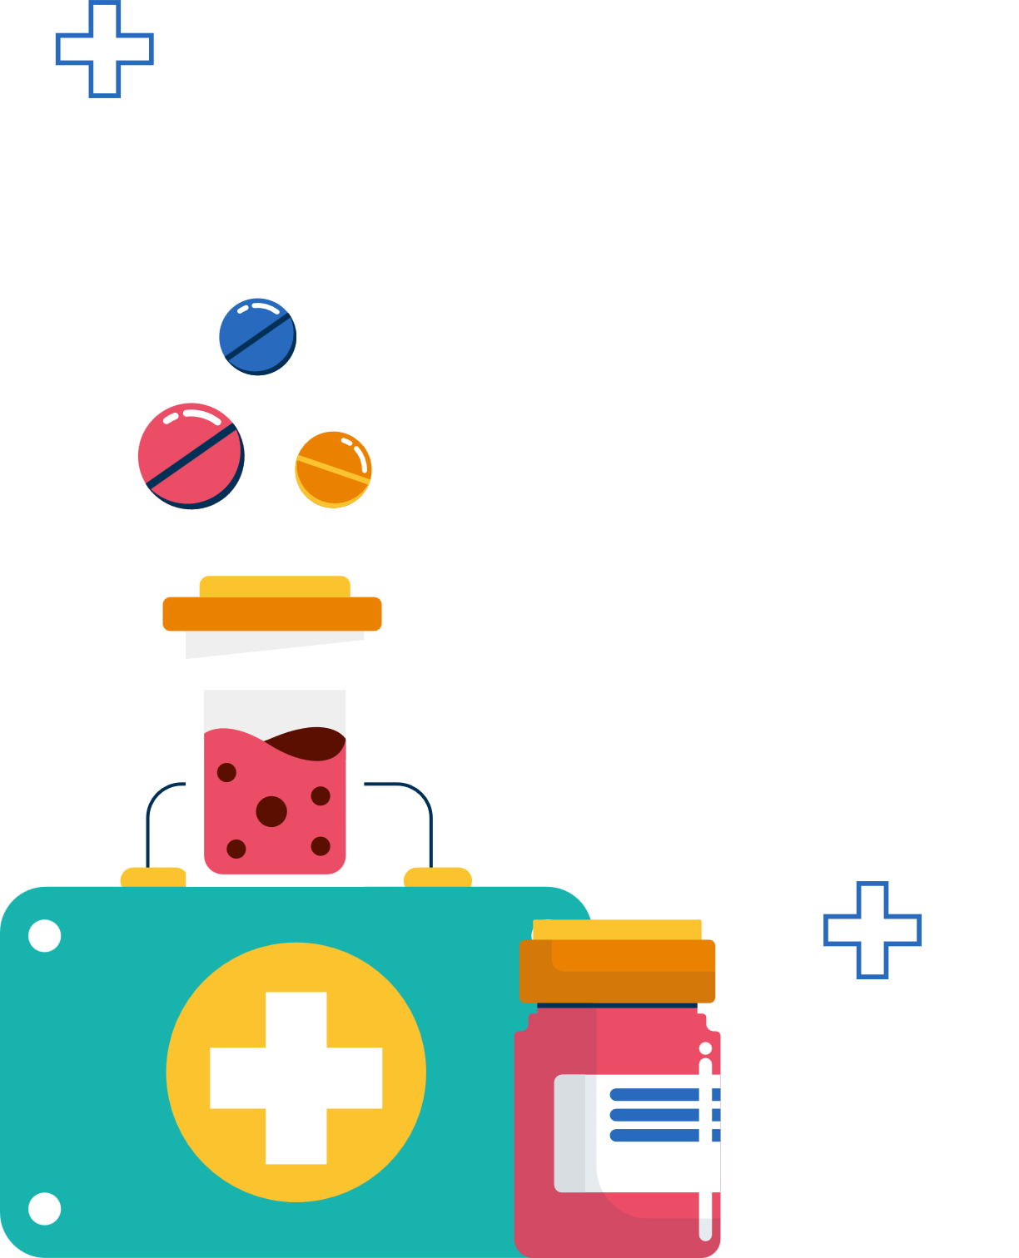
Sustainable Development Goals
12

Slide 12


References
https://www.cdc.gov/vaccines/hcp/admin/storage/toolkit/
https://ieeexplore.ieee.org
13

Slide 13


Conclusion
Our system enhances medicine safety, waste reduction, and treatment efficiency by integrating IoT for real-time monitoring, blockchain for traceability, and automated rejection.
Medicine effectiveness analysis ensures personalized recommendations, while FIFO inventory management optimizes stock usage and reduces expired medicine risks.
Aligning with global healthcare standards and SDGs, this scalable solution improves patient safety, compliance, and hospital efficiency, paving the way for a smarter, data-driven healthcare system.
14

Slide 14
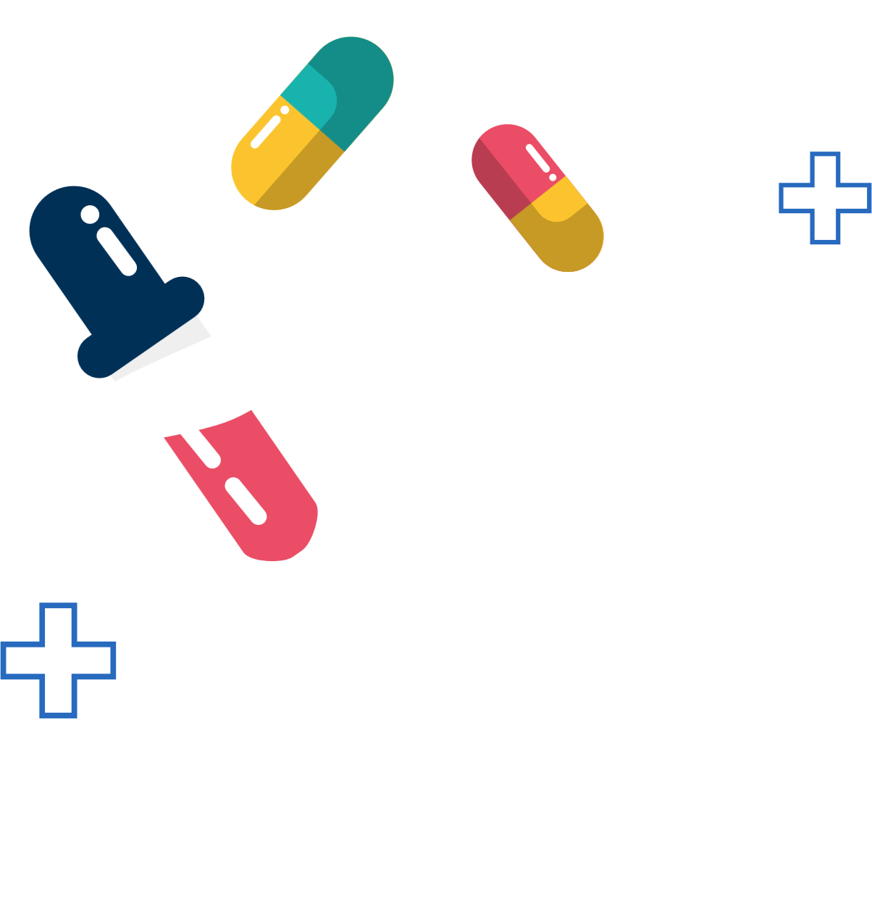

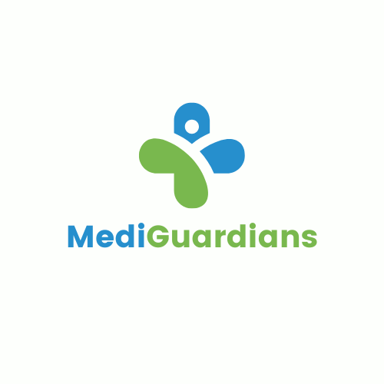


THANK
YOU!!!
15

